Slide 1
Clustering and PCA Assignment

Slide 2
Identifying impoverished countries: Abstract
Business Objective:
HELP International is an international humanitarian NGO that is committed to fighting poverty and providing the people of backward countries with basic amenities and relief during the time of disasters and natural calamities. To identify this, the top 5 most impoverished countries are selected and are divided the $10 million
Goals:
To find the top 5 impoverished countries.
Prediction Technique:
Clustering – K-Means and Hierarchical Clustering using Principal Component Analysis

Slide 3
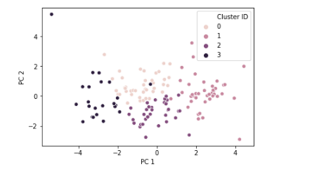
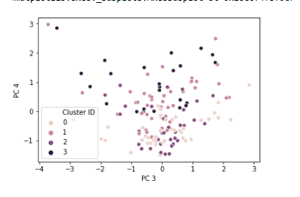
Solution Approach
Remove the outlier data, about 85% of the data is retained, this contains the higher range outliers only as the lower range outliers are critical.
Principal Component Analysis :
Features are transformed into components as linear combinations of the original variables.
While performing PCA, the K components of K-means algorithm is arrived at 4 and the its total variance is explained by 95%
Perform Clustering on these PCA’s to get clear clusters:

Slide 4
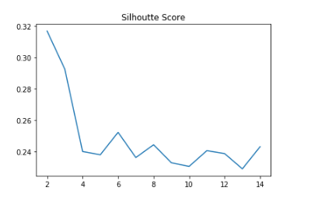
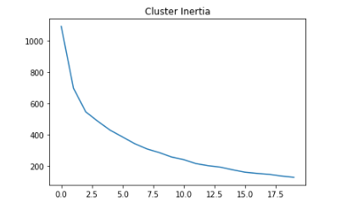
K- Means Clustering
Ideal Value of K is found by Silhouette Score and Elbow Curve:
With the output of these two, we can arrive at a conclusion that 4 is an optimum number for clustering, these are confirmed with the equal distribution of clusters also.

Slide 5
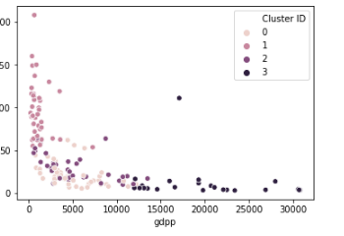
K means Clustering Results for countries
Clear Clusters are formed

Slide 6
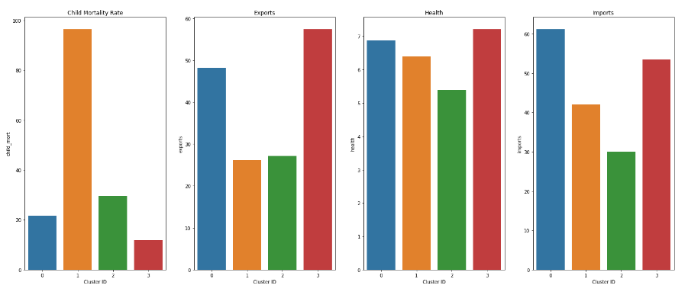
K means Clustering Results

Slide 7
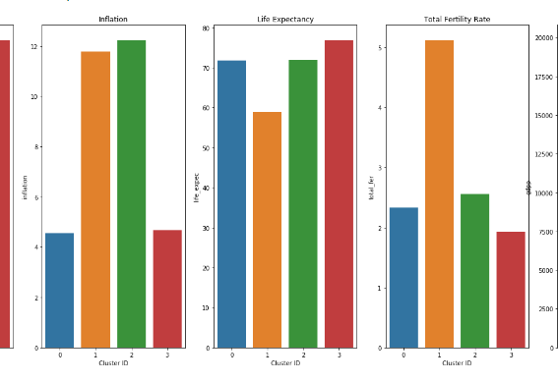
K means Clustering Results
Thus Cluster 2 is found to be the most under privileged cluster

Slide 8
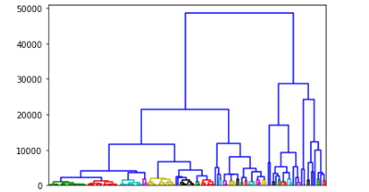
Hierarchical Clustering
The number of clusters are determined by the point on y-axis which cuts through maximum number of clusters.
K = 3 is optimal for this dendrogram.

Slide 9
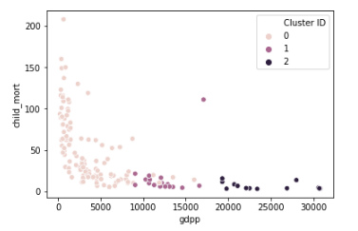
Hierarchical Clustering Results for countries
Clear Clusters are formed

Slide 10
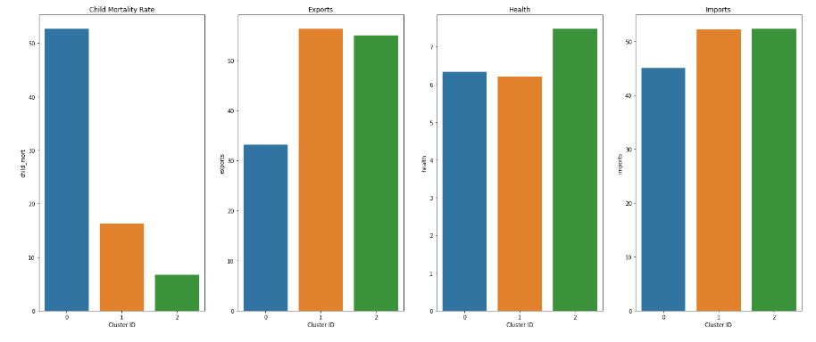
Hierarchical Clustering Results

Slide 11
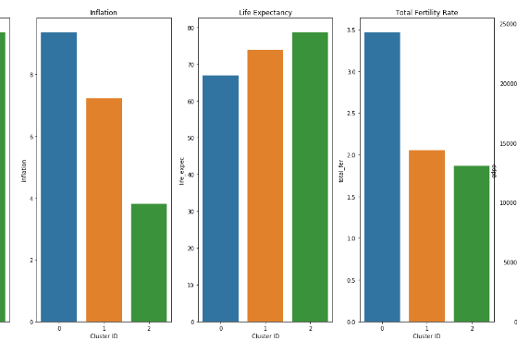
Hierarchical Clustering Results
Thus Cluster 0 is found to be the most under privileged cluster

Slide 12
Conclusion
Thus, Top 5 countries that are in dire help common to both hierarchical cluster 0 and k-means cluster 2 are :
1. Haiti
2. Sierra Leone
3. Chad
4. Central African Republic
5. Mali

